Slide 1




Marketing Executive Internship
SUBMITTED BY:
H.M. TAHSIN SHEIKH
ID: 22201243
SEC: E
SUBMITTED TO:
Hriday Sarkar
Supervisor of echithi

Slide 2

Drawbacks of eChithi
Limited Digital Reach
Potential customers may not know eChithi exists.
Low Product Visibility
Customers often search online before purchasing components.
Weak Content Marketing
Simply showing a product is less effective than showing what can be built with it.
High Competition
Customers can compare prices and products from multiple sellers.
Limited Customer Engagement
Students need guidance about which components are suitable for their projects.
Low Repeat Purchase Opportunity
After completing one project, customers may not automatically return.

Slide 3
Drawbacks SWOT Analysis
Strengths
Existing connection with UAP
Specialized robotics/electronics products
Student-focused customer base
Growing interest in robotics and IoT
Ability to provide project components in one place
Weaknesses
Limited brand awareness outside existing customers
Product information may not reach enough potential customers
Heavy dependence on direct/customer-based selling
Limited educational content and product demonstrations
Competition from online electronics marketplaces

Slide 4
Digital Marketing Solution
Use a 4-step digital marketing funnel:
Attract → Engage → Convert → Retain
Attract
Facebook
Instagram
YouTube
Google Search
Engage
Robotics tutorials
Project videos
Product
demonstrations
project showcases
Convert
Easy ordering
Product bundles
Student discounts
Project kit
Retain
Loyalty program
After-sales support
New product notifications
Community building
“Build a Line Following Robot with Arduino UNO – Complete Components Available at eChithi.”

Slide 5
Digital Marketing Strategies
Most important strategy:
Content + Social Media + University Community Marketing
Strategy | How eChithi Can Use It
Instagram | Reels, product demonstrations
YouTube | Complete tutorials
Content Marketing | Tutorials, guides and project ideas
Influencer Marketing | Collaborate with robotics creators
Email/WhatsApp Marketing | Offers and new product notifications
University Marketing | Work with university clubs and labs
Paid Advertising | Target students, makers and engineers

Slide 6
Suitable Strategies for eChithi
“Build → Teach → Show → Sell”
Instead of only selling components, eChithi can create content around what customers can build with those components.
Example campaign:
Product: ESP32 ↓ Content: “5 IoT Projects You Can Build with ESP32” ↓ Video: 30-second demonstration ↓ Call-to-action: “All required components available at eChithi.” ↓ Bundle: ESP32 + Sensor + Jumper Wire + Breadboard ↓ Purchase

Slide 7
Justification of Digital Marketing Strategies
Targeted Reach: Directly connects with eChithi’s core market—students, robotics enthusiasts, researchers, and makers.
Product Visibility:Demonstrations, tutorials, and project-based content clearly communicate the practical value of products.
Cost Efficiency: Digital channels provide broader reach with lower costs compared with traditional advertising.
Existing Advantage: eChithi’s collaboration with University of Asia Pacific (UAP) provides an established academic network.
Customer Engagement: Educational content builds trust and encourages continuous interaction with the brand.

Slide 8
Digital Marketing will Improve
Stats can present these as target KPIs, not guaranteed results:
KPI | Current Goal | 12-Month Target
Social Media Reach | Limited | +100–150%
Website/Online Visits | Limited | +100%
Customer Engagement | Low | +50–100%
Online Orders | Limited | +50–100%
Repeat Customers | Low | +30–50%
University Partnerships | Few | 5–10 institutions
Project Kit Sales | Emerging | Strong new revenue stream

Slide 9
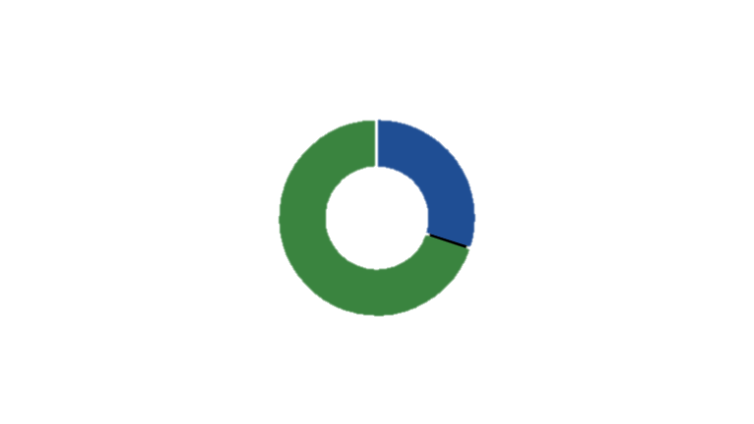
Cost VS Benefits
Expected Benefit
Marketing Cost
Expected Benefit: 70%
Increased sales
New customers
Repeat customers
University & student reach
Cost: 30%
Social media promotion
Paid advertising
Content creation
Influencer/online campaigns

Slide 10
eChithi next 5 years
From a component shop → to a complete robotics & electronics ecosystem.
Year 1: Build strong digital presence & online sales
Year 2: Expand university partnerships & student community
Year 3: Reach customers across Bangladesh
Year 4: Launch robotics, IoT & project kits
Year 5: Become a leading robotics & electronics component brand

Slide 11
Conclusion
Expected Future echithi:
More brand awareness
More students and makers reached
Increased online sales
More repeat customers
Stronger university relationships
Expansion into electronics and IoT
“eChithi should not only sell the components to build the next robot—it should become the platform that helps students build it.”

Slide 12

THANK YOU

